Slide 1

Web Application
Game Asset Trading
Group Member:
Siyu Tao
Jianyu Wang
Zhiqiang Ma
Yuheng Wang
Yunfei He
26 July, 2024

Slide 2
Introduction
In contemporary society, online games have become an important part of daily life,and many players have invested a lot of time and energy into them. This investment makes the player’s game account and its assets valuable. Therefore, there are risks such as asset loss and personal privacy leakage in the process of buying and selling online games.
To address this issue,our group process a game asset trading platform based on blockchain technology to effectively address security challenges during the transaction process.

Slide 3
Literature Review
Siyu Tao: Back-end code writing
Jianyu Wang: Front-end code writing
Zhiqiang Ma: Front-end code writing
Yuheng Wang: Presentation Slideshow Production
Yunfei He: Presentation Slideshow Production

Slide 4
Our Model
Game asset trading. You can log in on the designed interface, query game related information through API interface after logging in, and complete game asset transactions through blockchain. Blockchain technology ensures the security of transactions through encryption, making every transaction difficult to tamper with or steal. All transactions are publicly recorded on the blockchain, providing transparency for players. Among them, RPA can automatically extract data from the application and input it into another system; Regularly check specific data or status in the application.

Slide 5
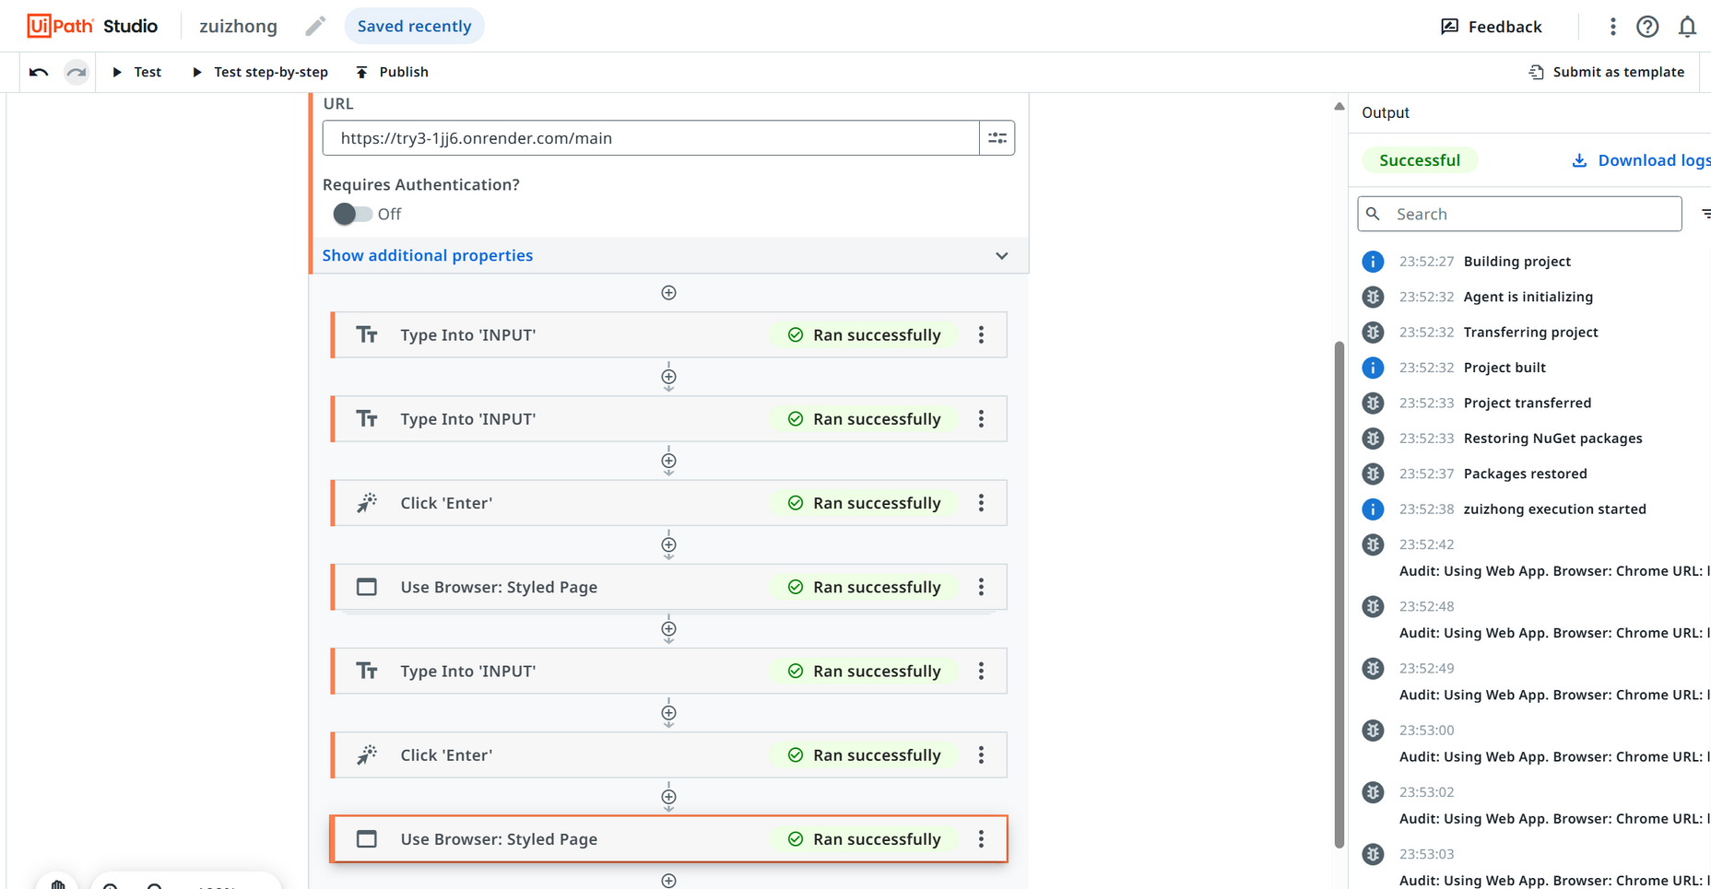
Achievements

Slide 6
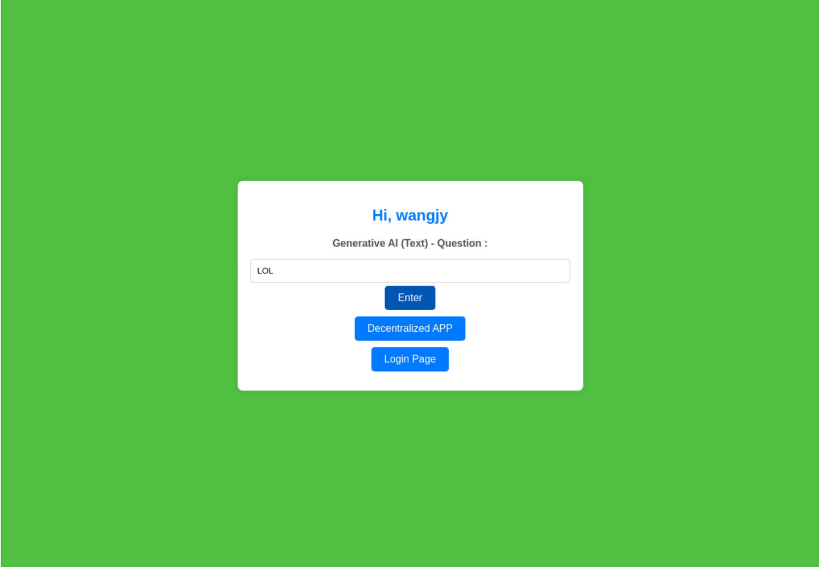
Achievements

Slide 7
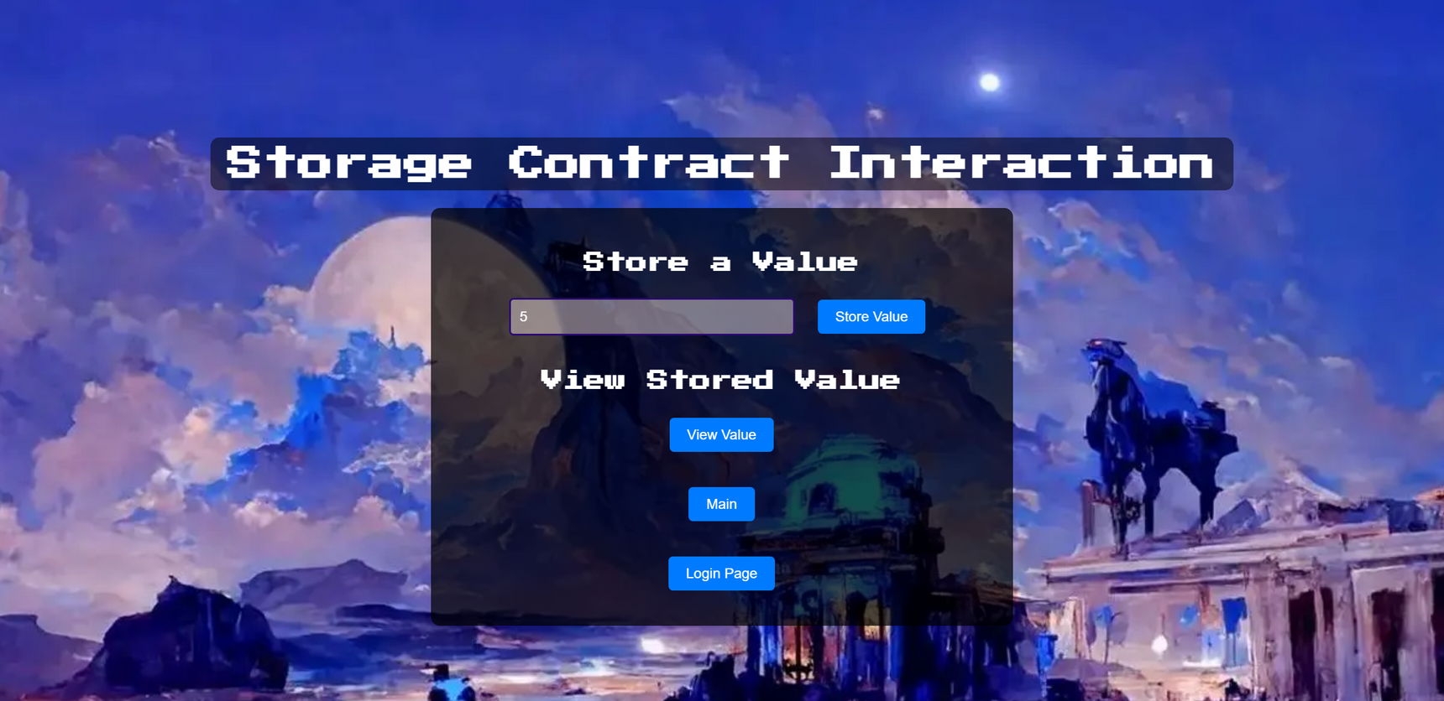
Achievements

Slide 8
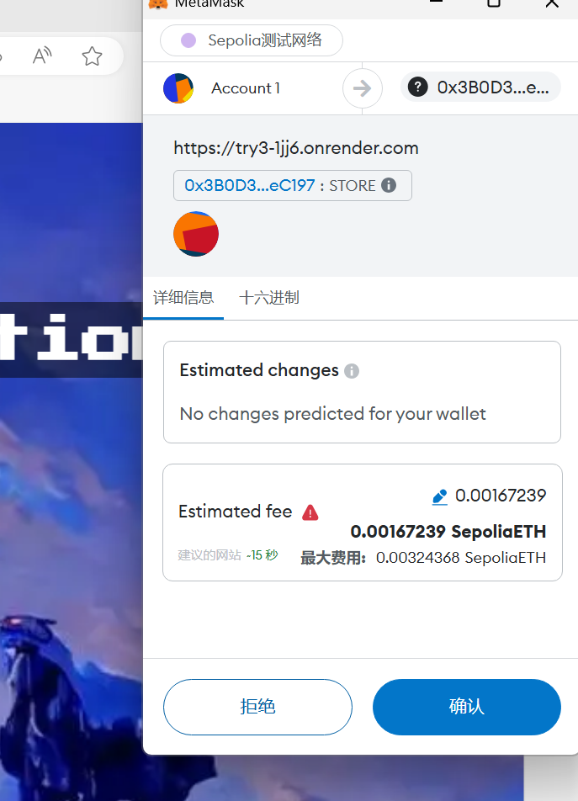
Achievements

Slide 9
Conclusion and Future Study
In conclusion, our web application addresses a significant problem by providing a streamlined and automated solution. By leveraging the capabilities of Robotic Process Automation (RPA), our application ensures efficient and accurate task execution, reducing human error and saving valuable time. This project has demonstrated the potential of integrating RPA with web applications to create more effective and user-friendly solutions.
Looking ahead, there are several avenues for further development and improvement. Future studies could focus on enhancing the user interface to make it even more intuitive and accessible. Additionally, expanding the scope of the application to handle more complex tasks and integrating advanced AI features could further increase its utility. Exploring cross-platform compatibility and ensuring robust security measures will also be critical in making this web application a comprehensive tool for broader use.

Slide 10
Thank you!
26 July, 2024

